Slide 1
Image Histogram
By-
Abhinaba Chowdhury
Abhiroop Mukherjee
Debarghya Dey
Jyotiprakash Roy
Shrutanten

Slide 2
1.) What is a Histogram?
In image processing and photography, a color histogram is a representation of the distribution of colors in an image. For digital images, a color histogram represents the number of pixels that have colors in each of a fixed list of color ranges, that span the image's color space, the set of all possible colors.

Slide 3
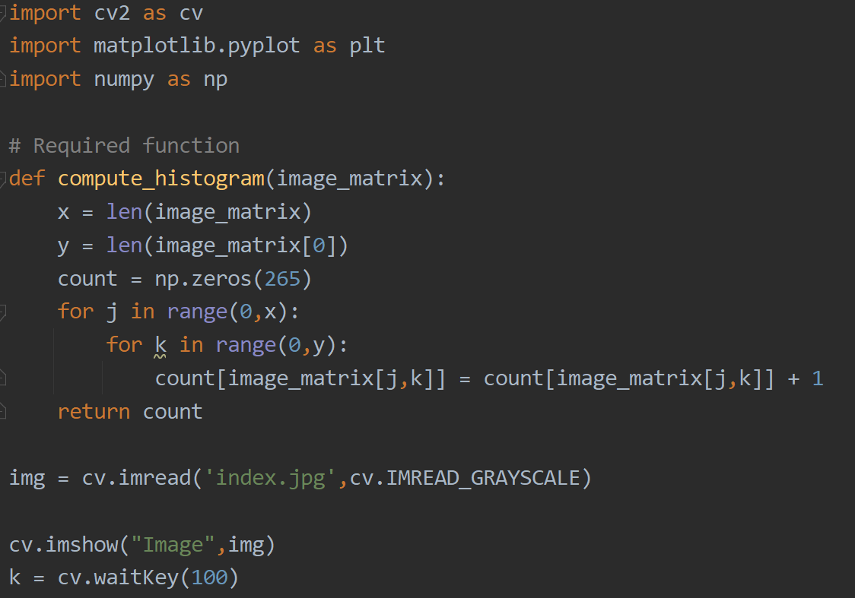
2.) Computing the histogram of a Grey level image
The Python code used here to compute the histogram of an image “index.jpg”:

Slide 4
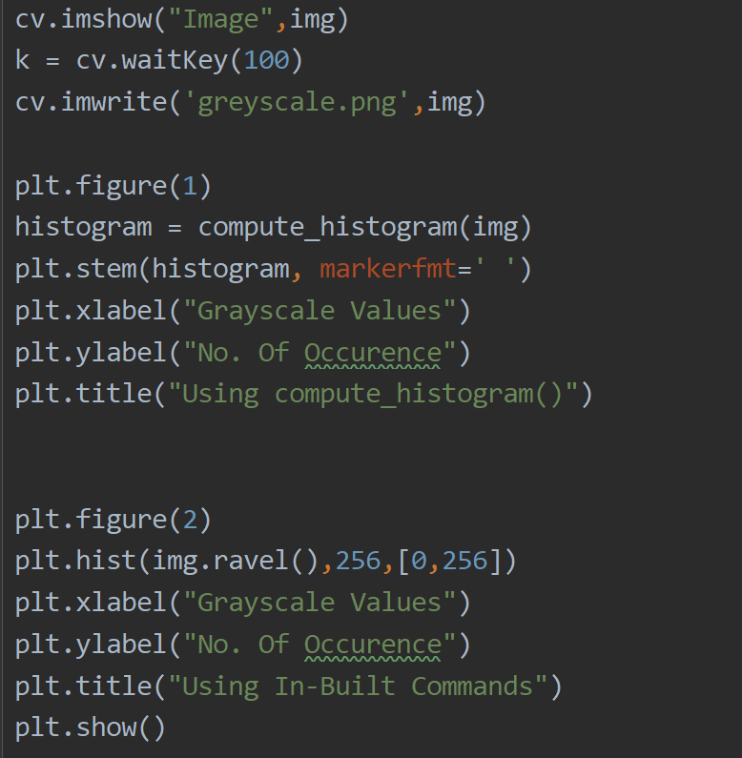
2.) Computing the histogram of a Grey level image (cont.)

Slide 5

2.) Computing the histogram of a Grey level image (cont.)
The image index.jpg

Slide 6
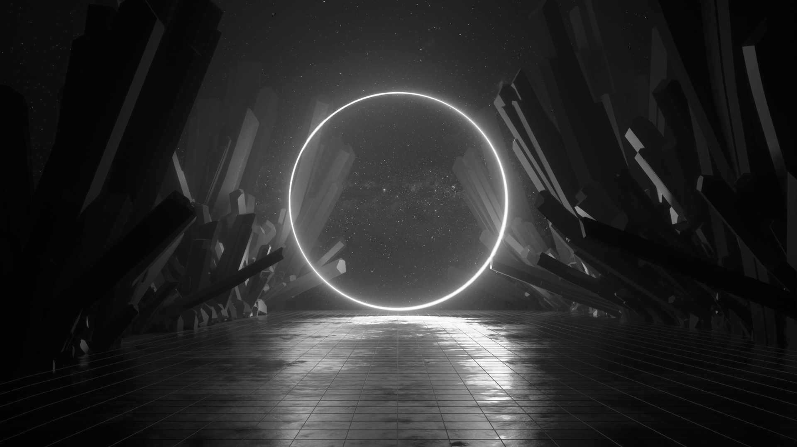
2.) Computing the histogram of a Grey level image (cont.)
Converted image greyscale.png

Slide 7
2.) Computing the histogram of a Grey level image (cont.)
Explanation:
1) def compute_histogram(image_matrix): This is the user defined function, which returns a list of number of occurrences of each grayscale value of the image, which ranges from 0-255.
2) cv.imread('image.png',cv.IMREAD_GRAYSCALE): This function reads the image in grayscale form.
3) cv.imshow("Image",img) and k = cv.waitKey(100): These lines show the image and keep it shown for the entire duration of program runtime. Here 100 is the amount of time (in ms) to wait after that the code will execute the next lines of the program.
4) cv.imwrite('greyscale.png',img): This line saves the grayscale form of the image as ‘grayscale.png’.

Slide 8
2.) Computing the histogram of a Grey level image (cont.)
5) plt.figure(1); histogram = compute_histogram(img); plt.stem(histogram, markerfmt = ‘ ’); plt.xlabel("Grayscale Values"); plt.ylabel("No. Of Occurrences"); plt.title("Using compute_histogram()"): These lines are used to make a figure, which is the histogram made by the user defined function. Here maplotlib.stem() is used with markerfmt=‘ ‘ so as to make the stem graph look like a histogram plot.
6) plt.figure(2); plt.hist(img.ravel(),256,[0,256]); plt.xlabel("Grayscale Values"); plt.ylabel("No. Of Occurence"); plt.title("Using In-Built Commands"): These lines are used to make a figure, which is the histogram, made by inbuilt functions contained in matplotlib and numpy. Here numpy.ravel() returns the value of the image matrix in a 1D array in row major format and matplotlib.hist() makes an histogram of the array returned. The second parameter 256 defines the number of bars to be displayed in the histogram and the third parameter defines the range of input to be displayed by the histogram.
7) plt.show(): This line shows all the figures made by matplotlib as a usable window, enabling user to visualise the figures made by the code.

Slide 9
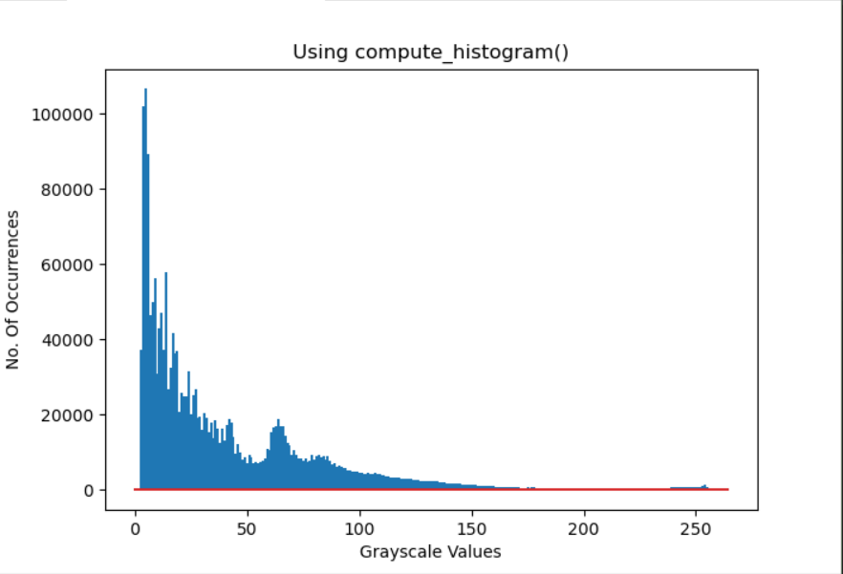
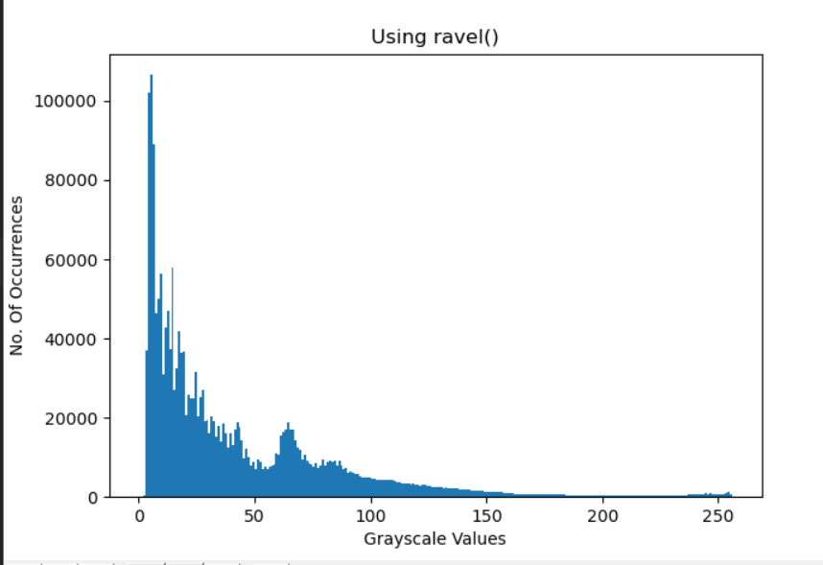
3.) Test of the computed histogram
Here is how the histogram computed by the compute_histogram() function compares to the one computed by OpenCV’s library function hist():

